Slide 1
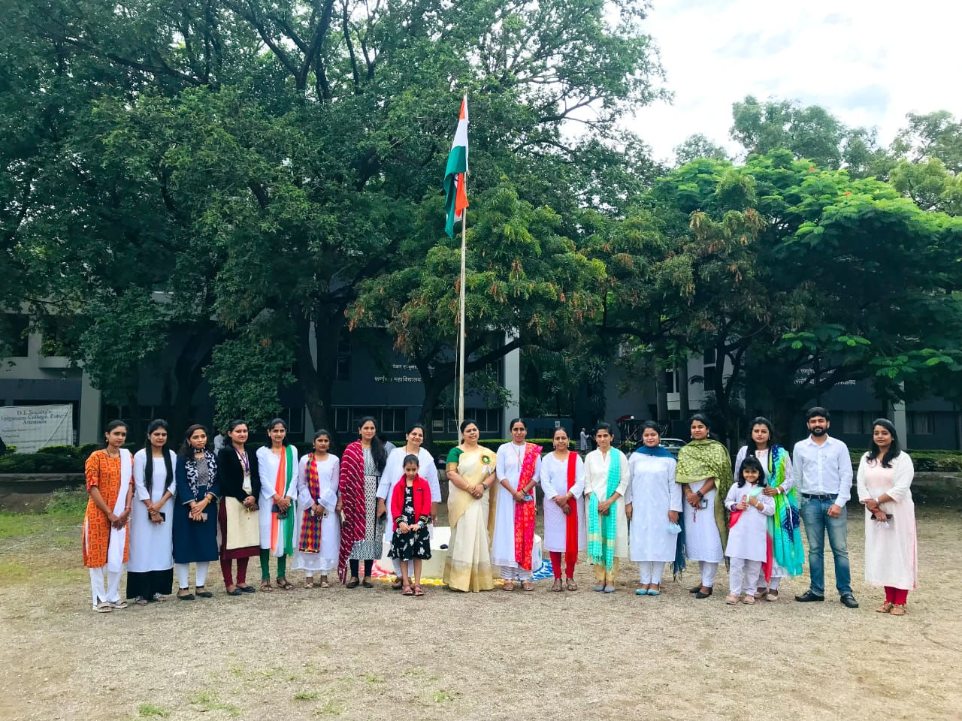
Independent &Republic day

Slide 2
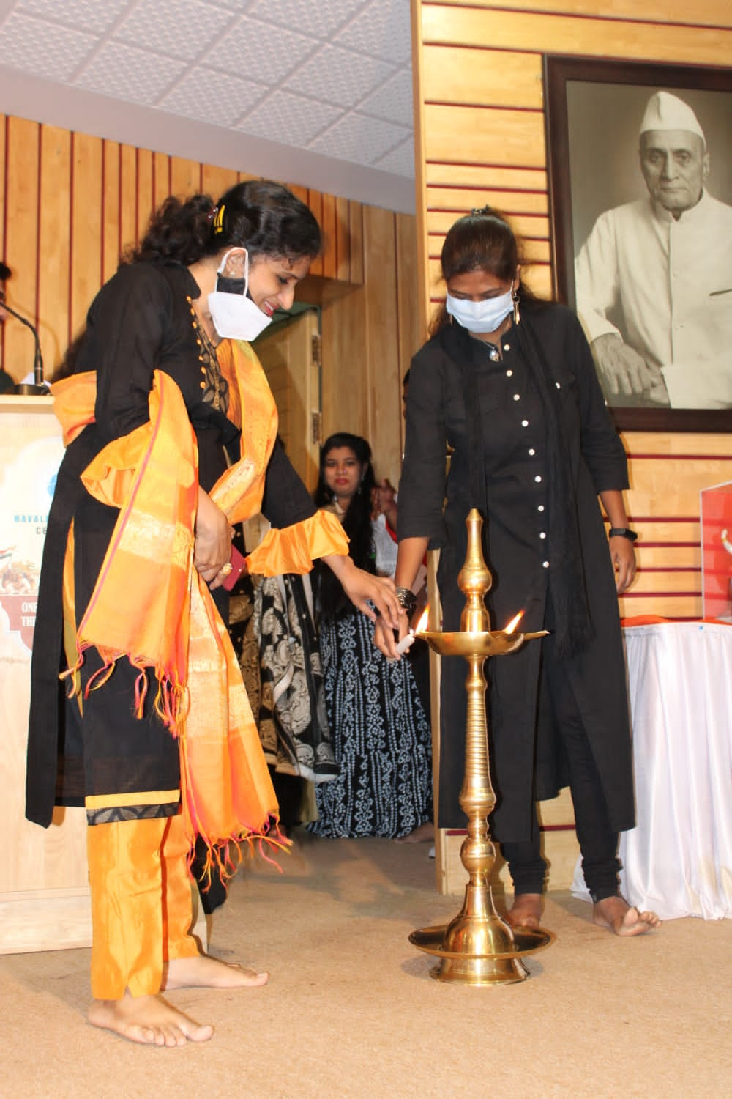
Teacher day

Slide 3
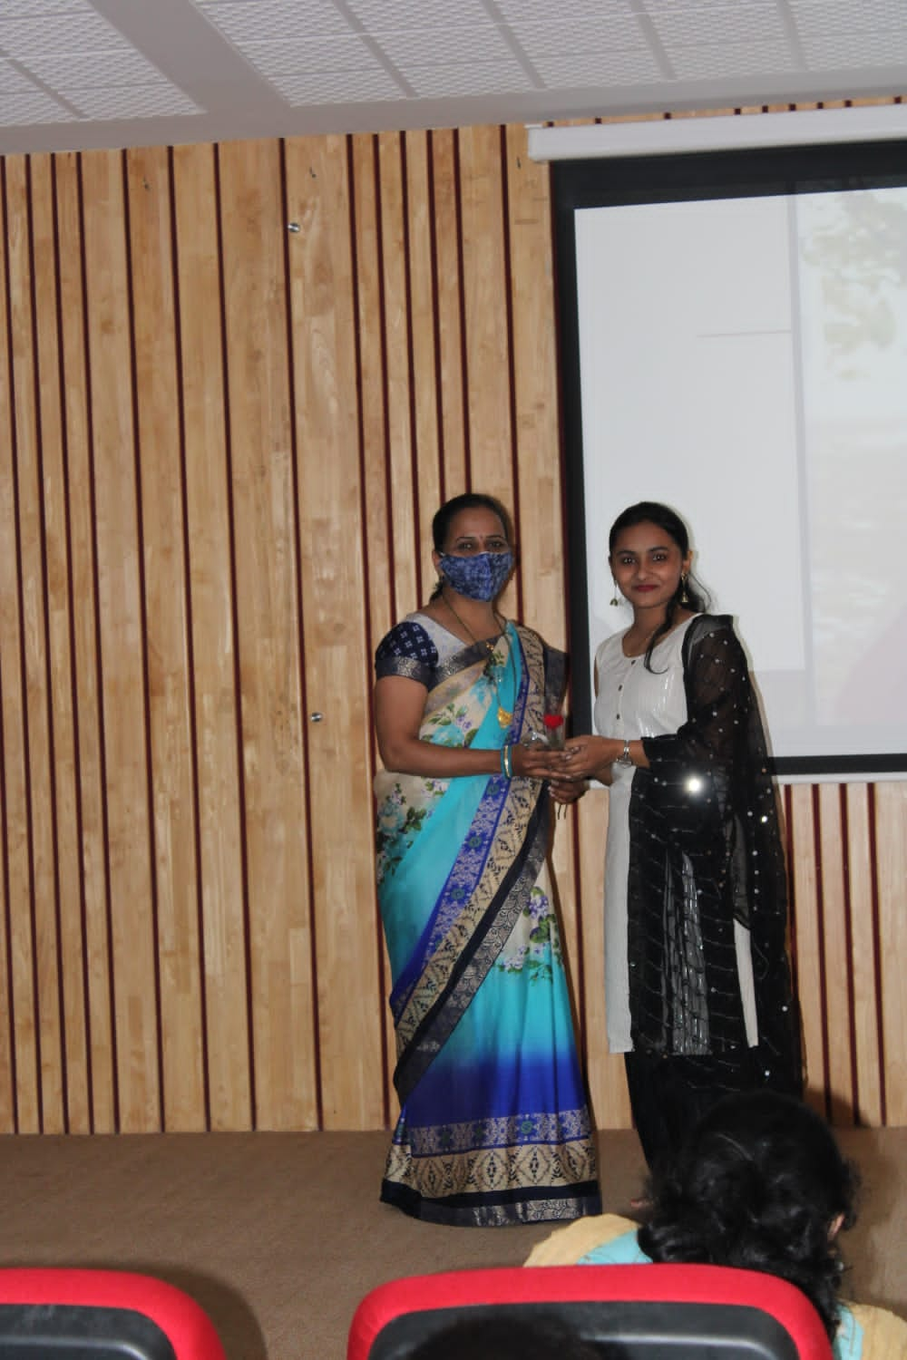

Slide 5
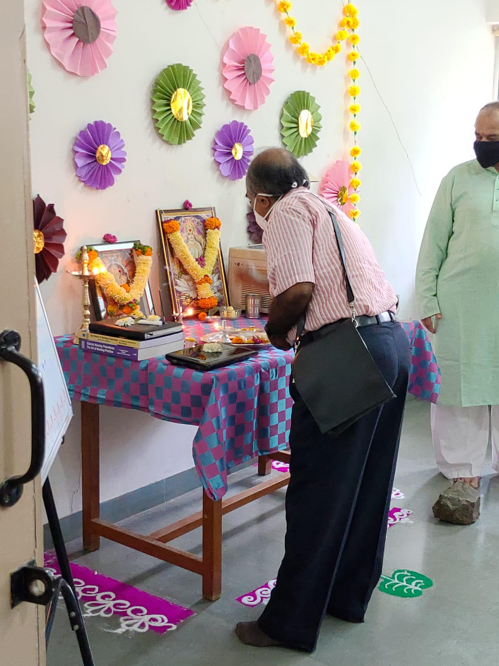
Dusshera celebration

Slide 6
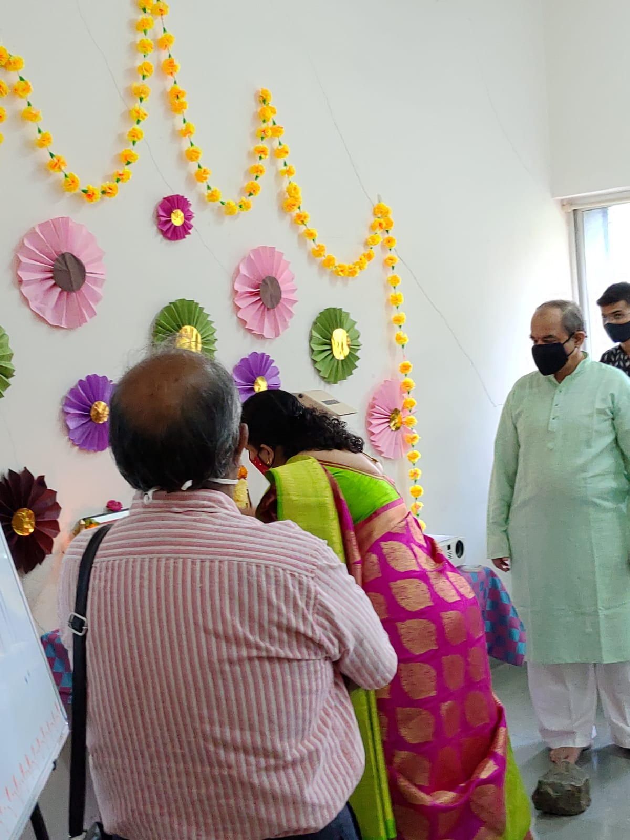

Slide 7
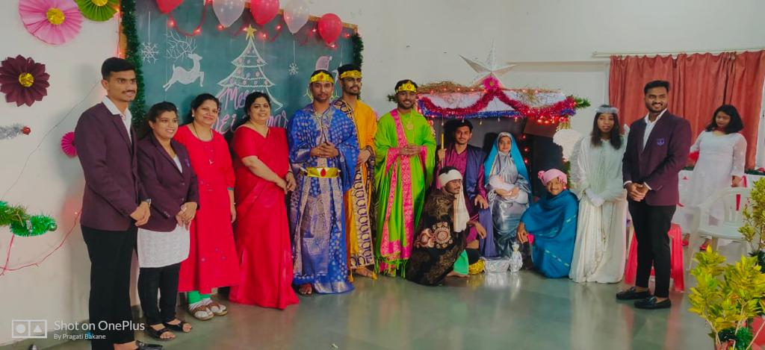
Christmas celebration

Slide 8
Farewell Party

Slide 9
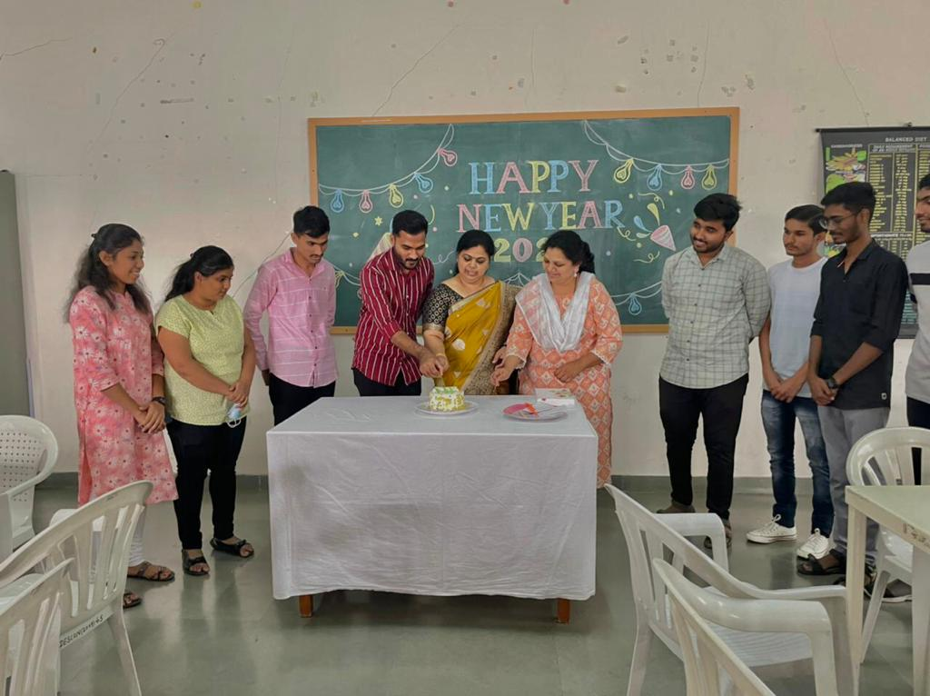
New year celebration

Slide 10
Freshers party-2022

Slide 11
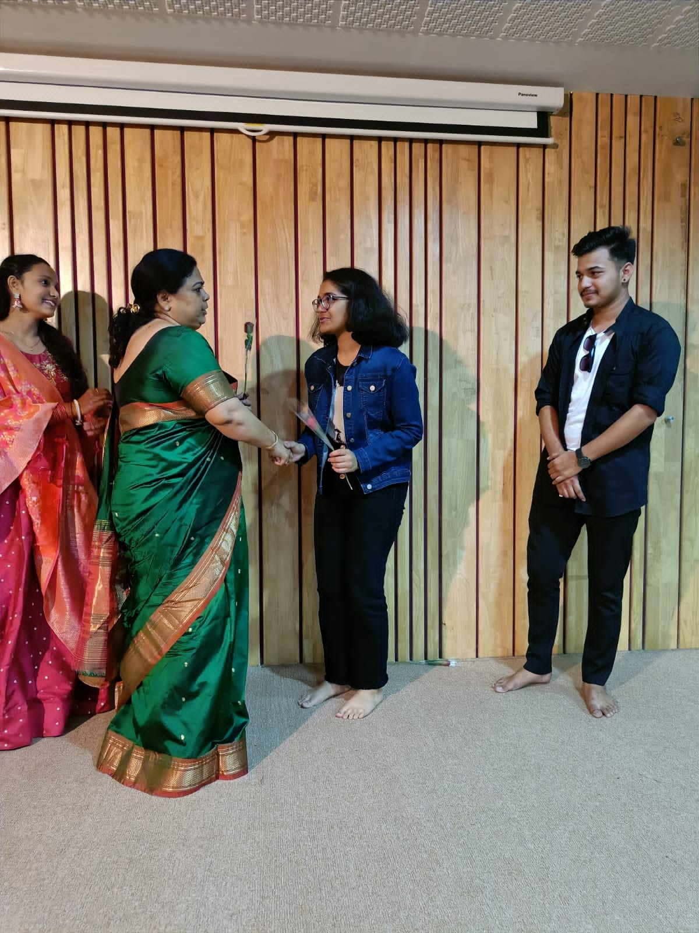

Slide 12
