Slide 1
D.E.S.SMT SUBHADRA K JINDAL COLLEGE OF NURSING SNA ACTIVITIES (2024-2025)

Slide 2
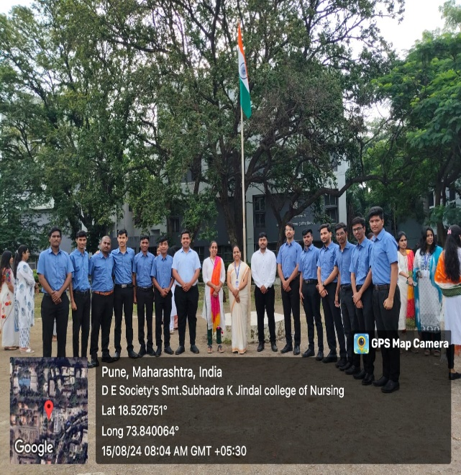
Independences Day

Slide 3
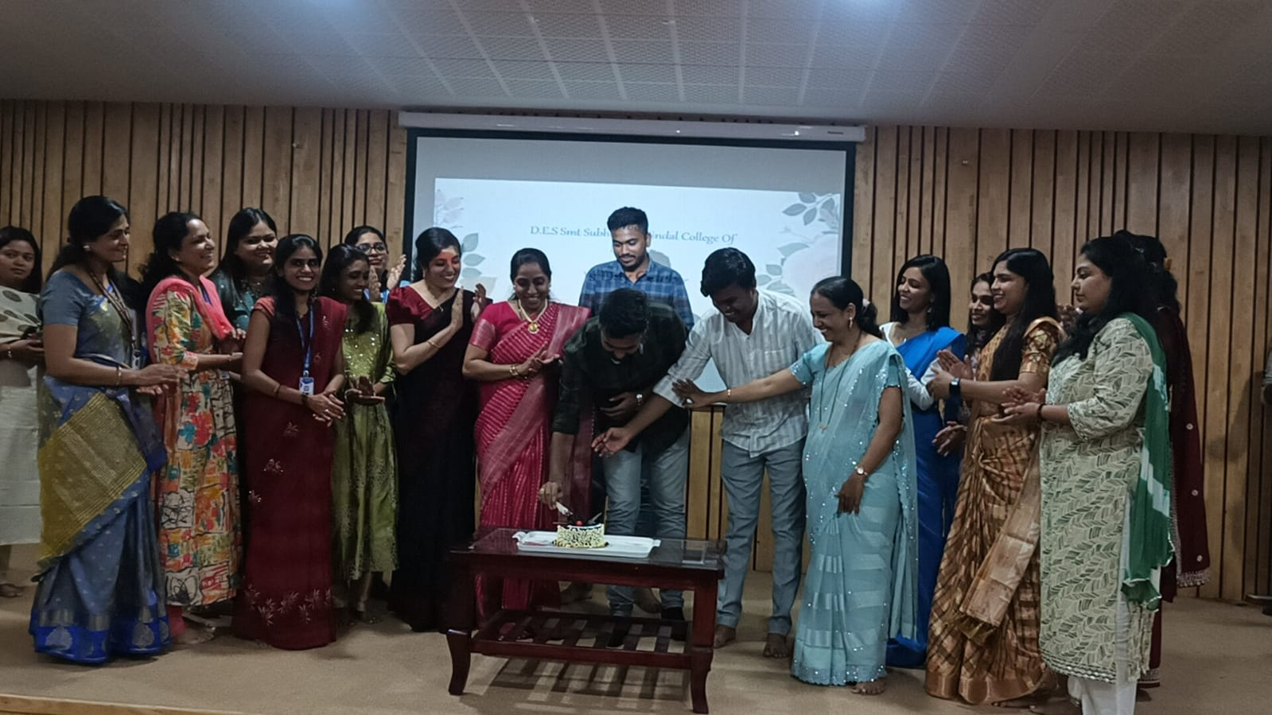
Teachers Day

Slide 4
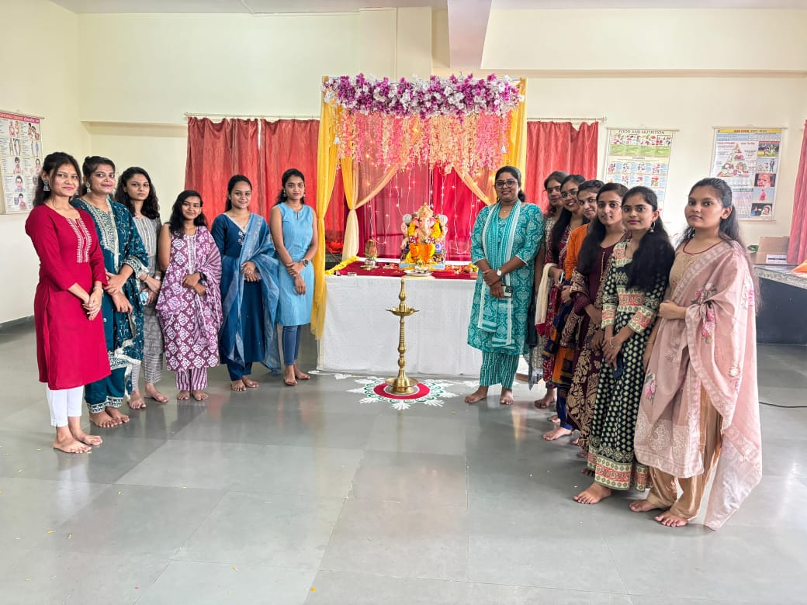
Ganpati Festival

Slide 5
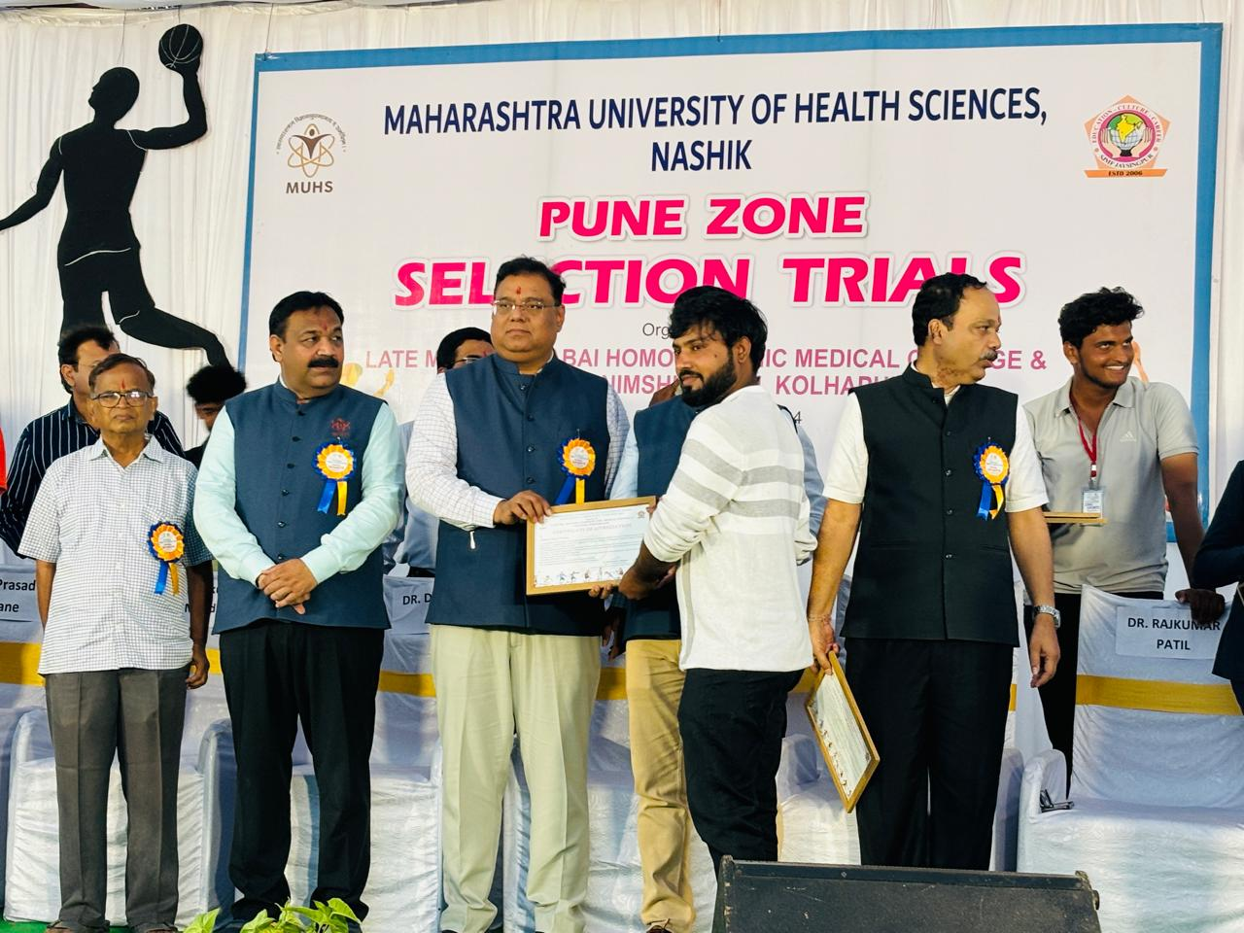
MUHS Krida Mahotsav

Slide 6
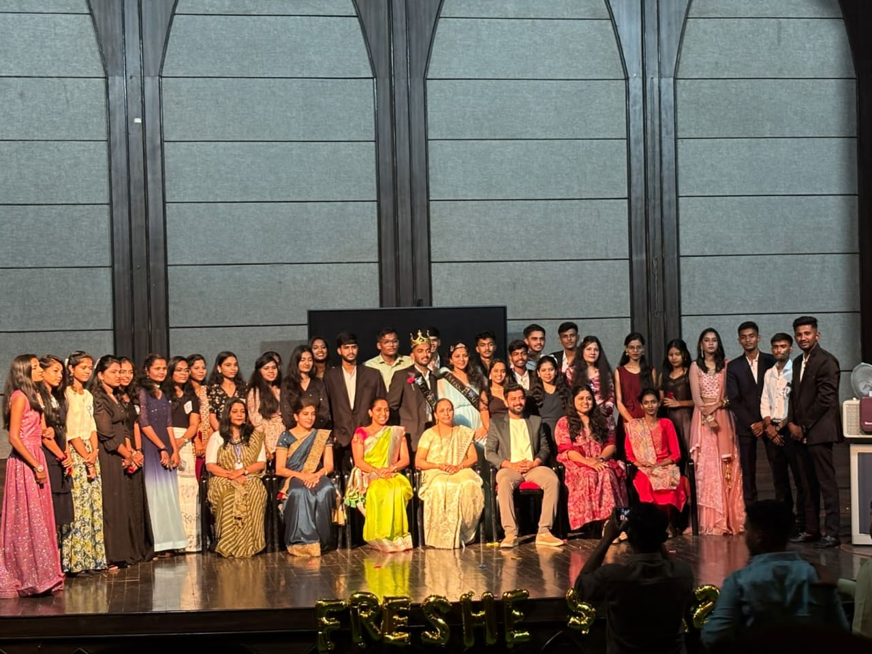
Fresher's Party

Slide 7
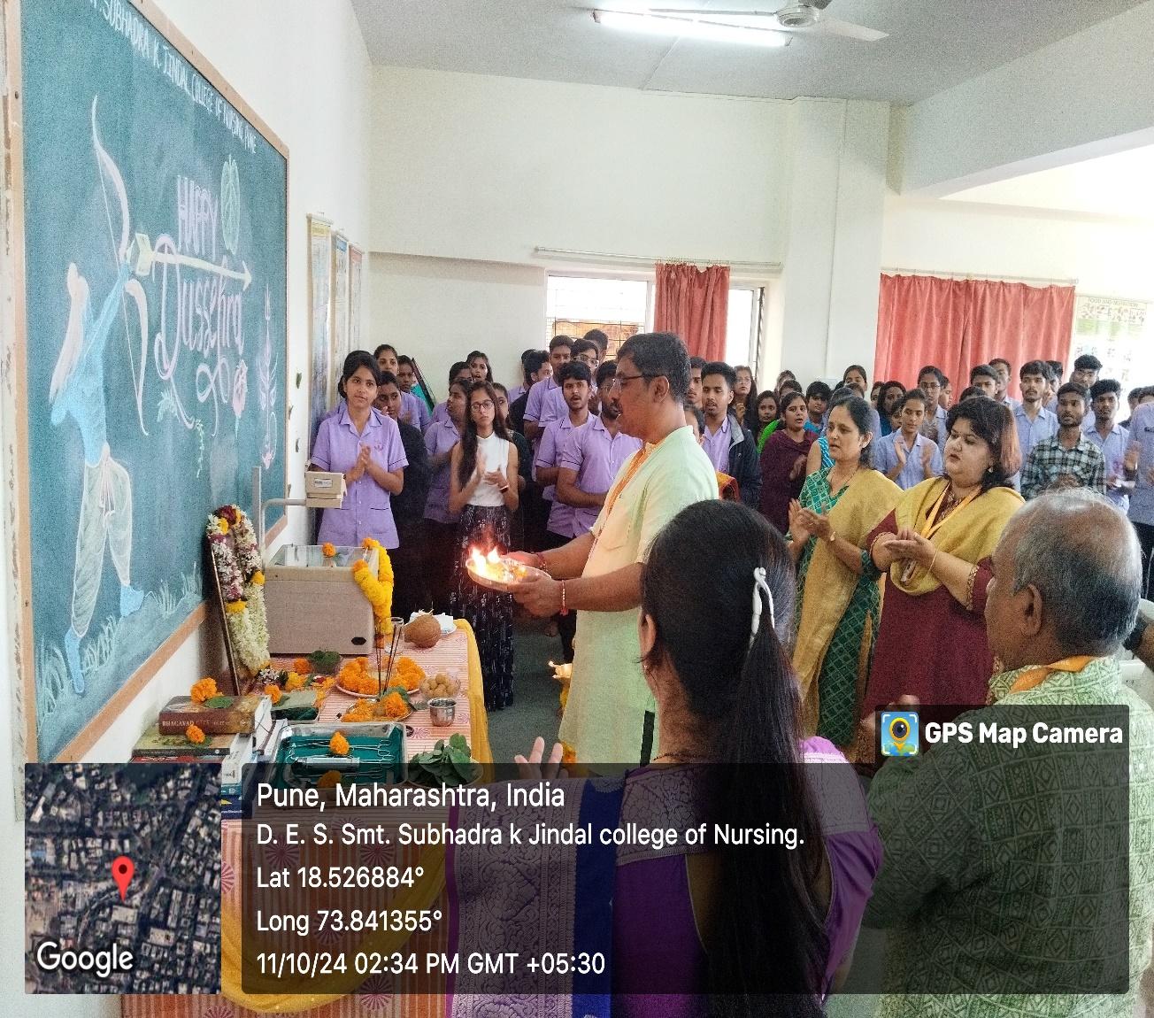
Dussehra Celebration

Slide 8
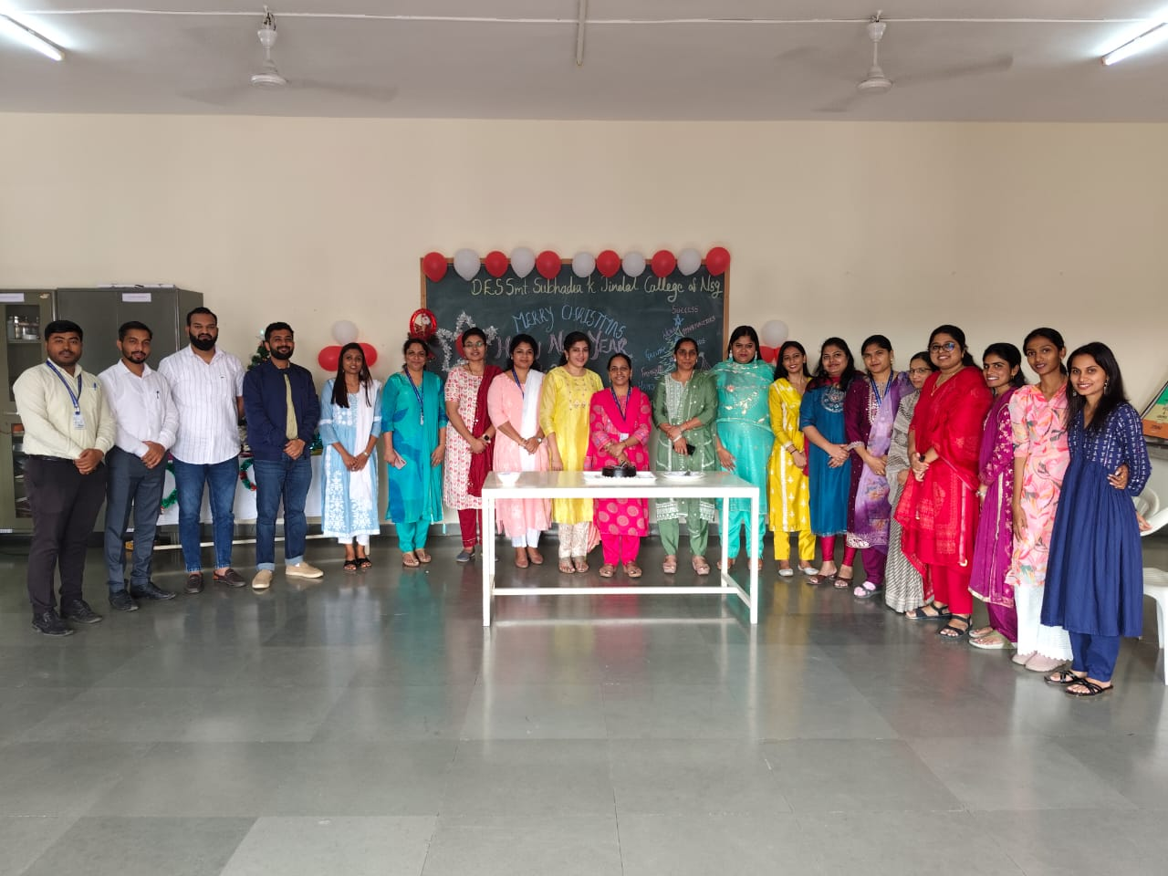
Christmas Celebration

Slide 9
New Year Celebration

Slide 10
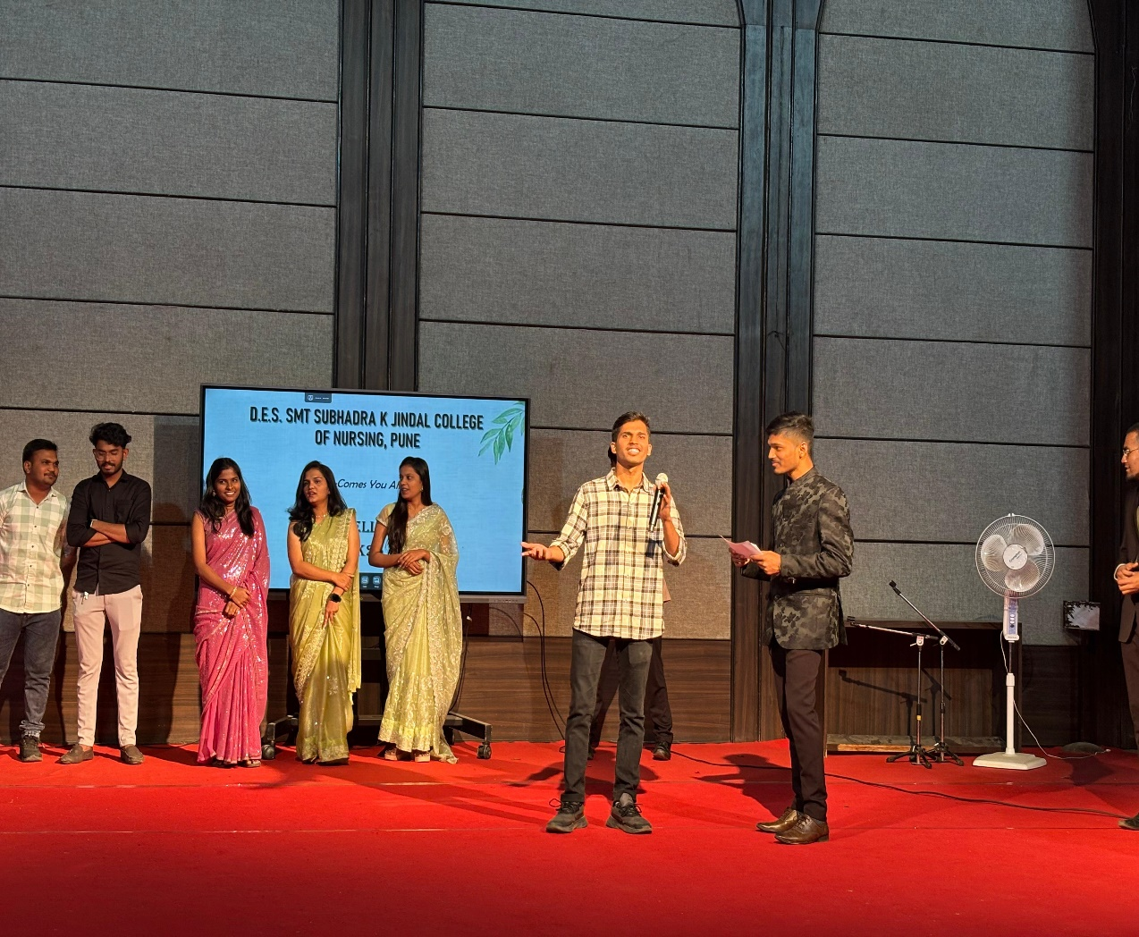
Farewell Party Celebration

